Slide 1
VANDERBILT UNIVERSITY ELECTIVE SURGERY SCHEDULE ANALYSIS
Shubham Goswami
Sujin Park
Vigneshwaran Giri Velumani

Slide 2
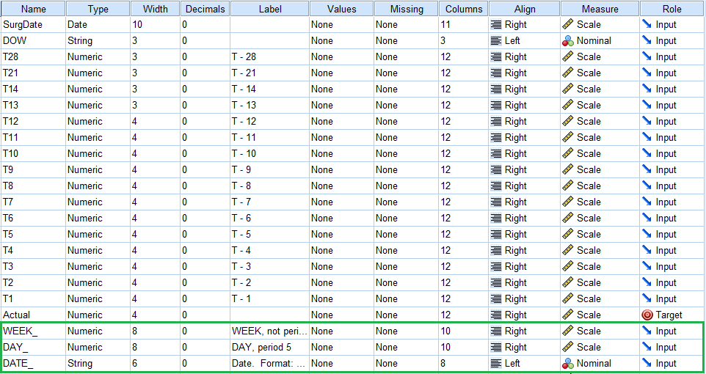
Data Exploration

Slide 3
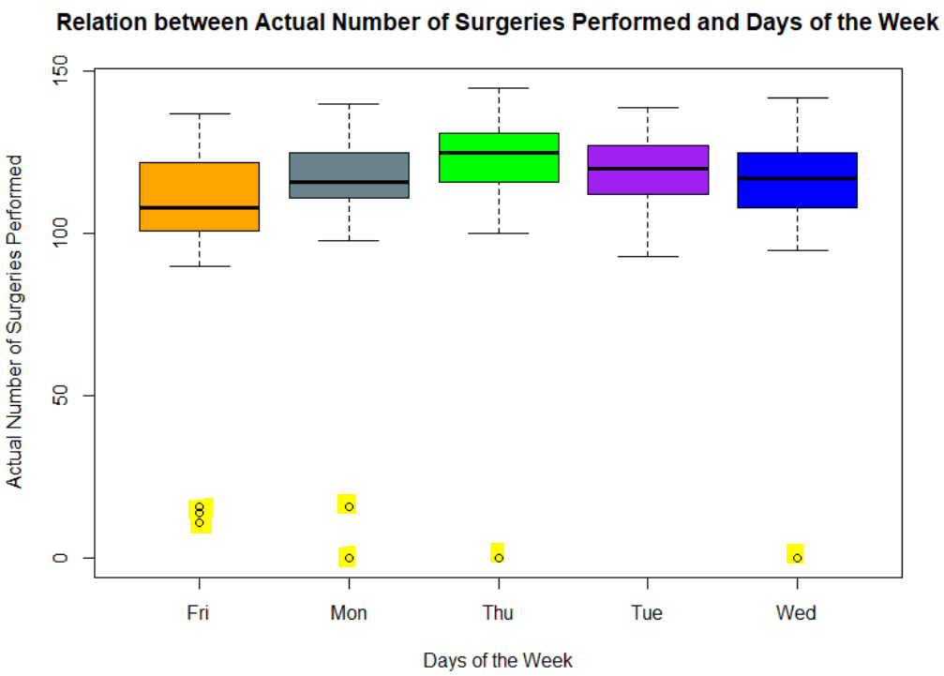
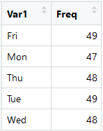
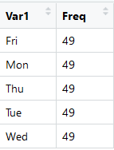
Data Preparation
Converted ‘SurgDate’ into Week & Day Format (e.g. Week 45 Day 5) as WEEK_ , DAY_ & DATE_ variables
Existing outlier rows
11/25/2011 Fri
12/23/2011 Fri
12/26/2011 Mon
12/30/2011 Fri
Imputed 4 missing rows with Values = ‘0’ to ensure consistency in periodicity :‘5’
24-Nov-11 Thu
28-May-12 Mon
04-Jul-12 Wed
03-Sep-12 Mon
Data Split
Training: Week 1 Day 1 till Week 45 Day 5
Test: Week 46 Day 1 till Week 49 Day 5

Slide 4
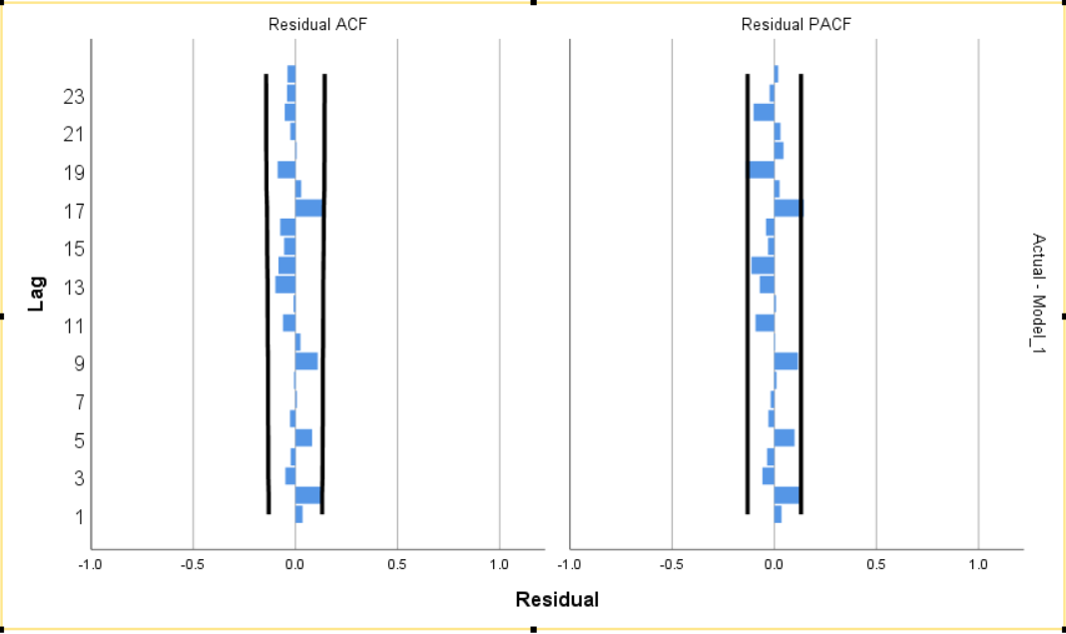
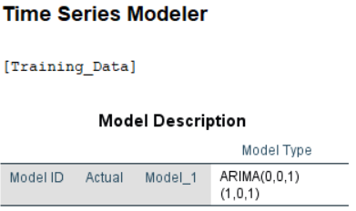
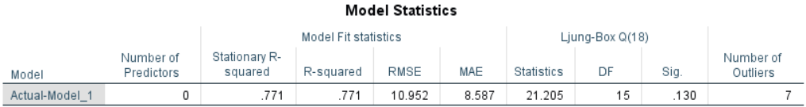
Time Series Modeler (Baseline Model)
Dependent Variable – Actual
Method : Expert Modeler
Model Type: All Models
Statistics for Comparing Models: Goodness of fit
Fit Measures: R square, Root Mean Square Error (RMSE) & Mean Absolute Error(MAE)
Outlier Detection – Additive & Level Shift

Slide 5
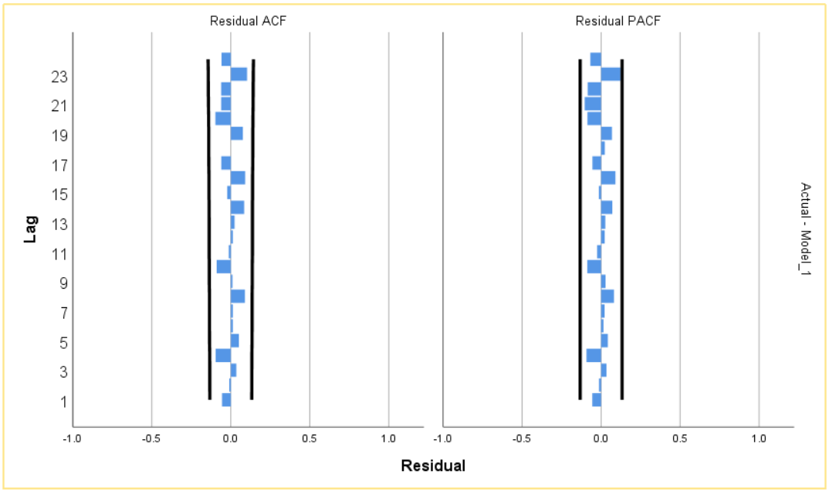
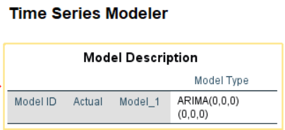
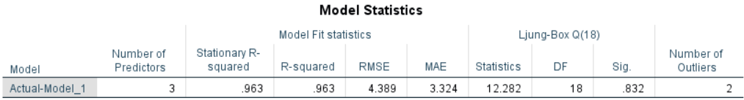
Model with highest R-squared value
Dependent Variable – Actual
Independent Variables – ‘T-1’,’T-2’,’T-3’,’T-4’, ’T-5’,’T-6’
Method : Expert Modeler
Model Type: All Models
Statistics for Comparing Models: Goodness of fit
Fit Measures: R square, Root Mean Square Error (RMSE) & Mean Absolute Error(MAE)
Outlier Detection – Additive

Slide 6
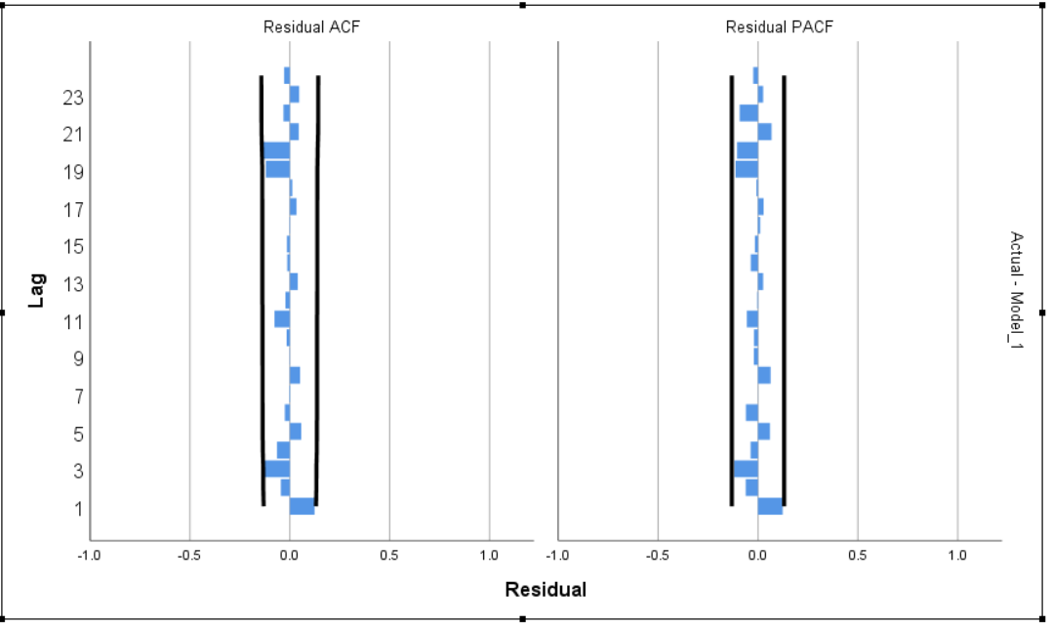
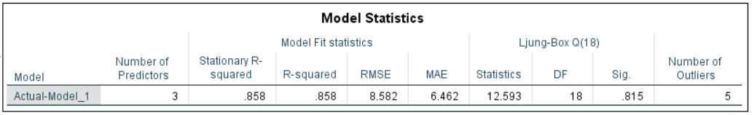
Model to predict 10 days before Actual Date
Dependent Variable – Actual
Independent Variables – ‘T-14’,’T-13’,’T-12’,’T-11’, ’T-10’
Method : Expert Modeler
Model Type: All Models
Statistics for Comparing Models: Goodness of fit
Fit Measures: R square, Root Mean Square Error (RMSE) & Mean Absolute Error(MAE)
Outlier Detection – Additive

Slide 7
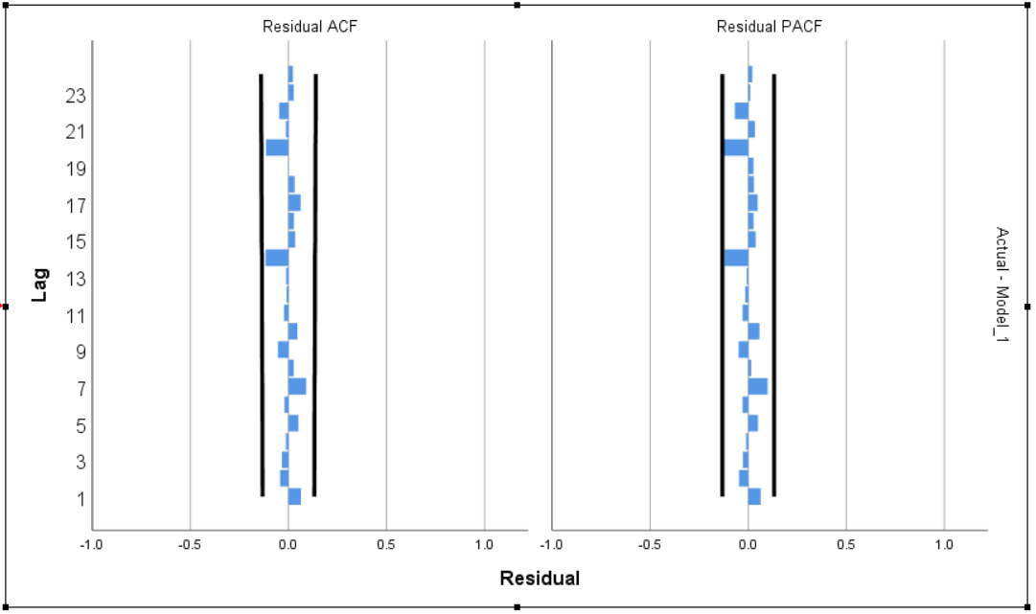
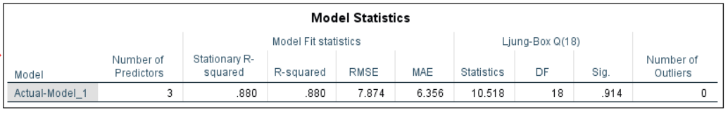
Model to predict 7 days before Actual Date
Dependent Variable – Actual
Independent Variables – ’T-10’, ’T-9’, ’T-8’, ’T-7’
Method : Expert Modeler
Model Type: All Models
Statistics for Comparing Models: Goodness of fit
Fit Measures: R square, Root Mean Square Error (RMSE) & Mean Absolute Error(MAE)
Outlier Detection – Additive

Slide 8
Model Comparison
Model | Independent Variables | R-squared | RMSE | MAE
Baseline | --- | 0.771 | 10.952 | 8.587
Highest R-squared | ‘T-1’,’T-2’,’T-3’,’T-4’,’T-5’,’T-6’ | 0.963 | 4.389 | 3.324
10 Days Before | ‘T-14’,’T-13’,’T-12’,’T-11’,’T-10’ | 0.858 | 8.582 | 6.462
7 Days Before | ’T-10’, ’T-9’, ’T-8’, ’T-7’ | 0.880 | 7.874 | 6.356
Findings:
Trade off between ‘Accuracy’ and ‘Number of days’ in Advance Prediction is made
Predictions of the final volume made 10 days before the day of surgery (TMinus10) were within ±7 cases 85.8% of the time as compared to (TMinus7) which gave similar results
So this model can be used to make staffing decisions

Slide 9
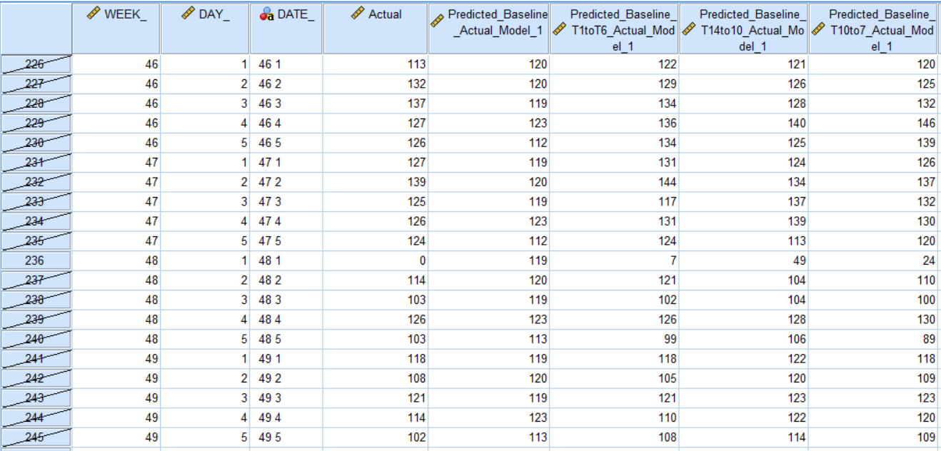
Forecast
Trade off between ‘Accuracy’ and ‘Number of days in Advance Prediction is made’

Slide 10
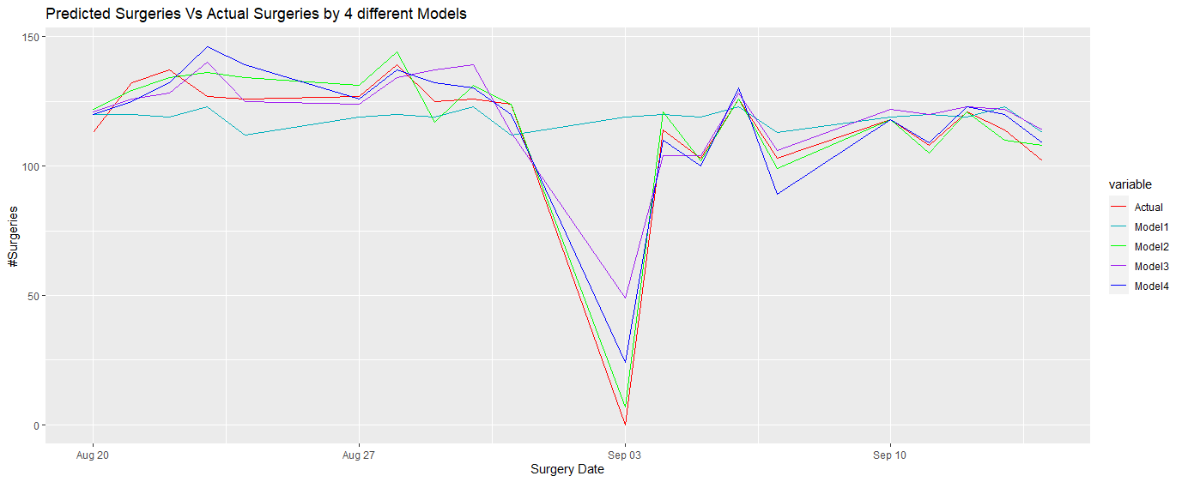
Forecast

